Slide 1
ICT407: IT Governance in Organisations
Week 7:
Lecturer: Dr. Farshid Keivanian

Slide 2
IT Governance
Introduction: IT governance is the framework that ensures IT resources are used to support the organization's overall goals and objectives. It provides a structure for decision-making, risk management, performance measurement, and regulatory compliance, all of which contribute to increasing stakeholder confidence.

Slide 3
IT Governance
Practical Scenario: Imagine you are working in a large retail company based in Sydney, such as "RetailCo," where IT investments need to align with business strategies. The company is expanding its e-commerce platform, and the IT department must ensure that all investments in technology support this growth and add value to the business.
Class Discussion Question: How can RetailCo ensure that its IT investments are strategic and deliver value to the organization? What role does IT governance play in this process?

Slide 4
IT Governance
Responses:
Implementing a clear IT governance framework to guide decision-making.
Aligning IT projects with business objectives to ensure they contribute to business growth.
Regularly reviewing IT investments to ensure they are delivering expected outcomes.

Slide 5
IT Governance
Multiple-Choice Question: What is the primary purpose of IT governance?
To control IT spending
To align IT resources with business goals
To implement new technologies quickly
To manage day-to-day IT operations

Slide 6
IT Governance Framework Components
Introduction: A well-defined IT governance framework includes several key components: decision-making structures, risk management, performance measurement, regulatory compliance, ethics, and accountability.

Slide 7
IT Governance Framework Components
Practical Scenario: Consider a government agency in Canberra, "GovTech," which is responsible for ensuring that all IT systems comply with strict regulatory standards. GovTech is planning to implement a new data management system. The agency needs to ensure that this system meets all regulatory requirements and is managed in an ethical and accountable manner.
Class Discussion Question: What steps should GovTech take to ensure that its new data management system complies with regulatory standards and adheres to ethical practices?

Slide 8
IT Governance Framework Components
Responses:
Conducting a thorough risk assessment before implementation.
Establishing clear ownership and accountability for compliance.
Regular audits and reviews to ensure ongoing adherence to regulations.

Slide 9
IT Governance Framework Components
Multiple-Choice Question: Which of the following is NOT a component of IT governance?
Decision-making structures
Performance measurement
Marketing strategy
Risk management

Slide 10
Aligning IT with Business
Introduction: IT governance is not just about technology; it's about aligning IT with the business. This alignment ensures that IT investments are strategic and contribute to the overall success of the organization.

Slide 11
Aligning IT with Business
Practical Scenario: "TechSolutions," a software development company in Melbourne, is planning to enter a new market. The company needs to ensure that its IT strategy is aligned with its business expansion plans to support this move effectively.
Class Discussion Question: How can TechSolutions align its IT strategy with its business expansion goals? What challenges might the company face in this alignment process?

Slide 12
Aligning IT with Business
Responses:
Ensuring IT and business leaders collaborate on strategic planning.
Aligning IT projects with key business objectives such as market expansion.
Addressing potential challenges like resource constraints or differing priorities.

Slide 13
Aligning IT with Business
Multiple-Choice Question: Why is it important for IT to be aligned with the business?
To reduce IT costs
To ensure IT projects support business goals
To implement the latest technologies
To focus solely on IT operations

Slide 14
Managing Risks in IT Governance
Introduction: A critical part of IT governance is managing the risks associated with IT use. This involves identifying potential risks, assessing their impact, and implementing measures to mitigate them.

Slide 15
Managing Risks in IT Governance
Practical Scenario: "BankCorp," a financial institution in Brisbane, is planning to launch a new online banking platform. The IT department must ensure that all risks related to data security, system availability, and compliance are managed effectively.
Class Discussion Question: What risk management strategies should BankCorp implement to ensure the success and security of its online banking platform?

Slide 16
Managing Risks in IT Governance
Responses:
Conducting a comprehensive risk assessment during the planning phase.
Implementing robust security measures, including encryption and access controls.
Continuously monitoring the platform for potential threats and vulnerabilities.

Slide 17
Managing Risks in IT Governance
Multiple-Choice Question: What is the first step in managing IT risks?
Implementing security measures
Conducting a risk assessment
Monitoring IT systems
Developing a compliance plan

Slide 18
Performance Measurement in IT Governance
Introduction: Performance measurement in IT governance involves evaluating how well IT resources are being used to meet business objectives. This includes tracking key performance indicators (KPIs) and making adjustments as needed.

Slide 19
Performance Measurement in IT Governance
Practical Scenario: "EduTech," an educational technology provider in Canberra, has implemented a new learning management system (LMS). The IT department needs to measure the system's performance to ensure it meets the needs of educators and students.
Class Discussion Question: What KPIs should EduTech use to measure the success of its new LMS? How can the company ensure that the system continues to deliver value?

Slide 20
Performance Measurement in IT Governance
Responses:
Tracking user satisfaction and system uptime.
Monitoring system usage and engagement metrics.
Regularly reviewing and updating the system based on feedback and performance data.

Slide 21
Performance Measurement in IT Governance
Multiple-Choice Question: Which of the following is an example of a performance measurement in IT governance?
User satisfaction surveys
System installation
Budget allocation
Risk assessment

Slide 22
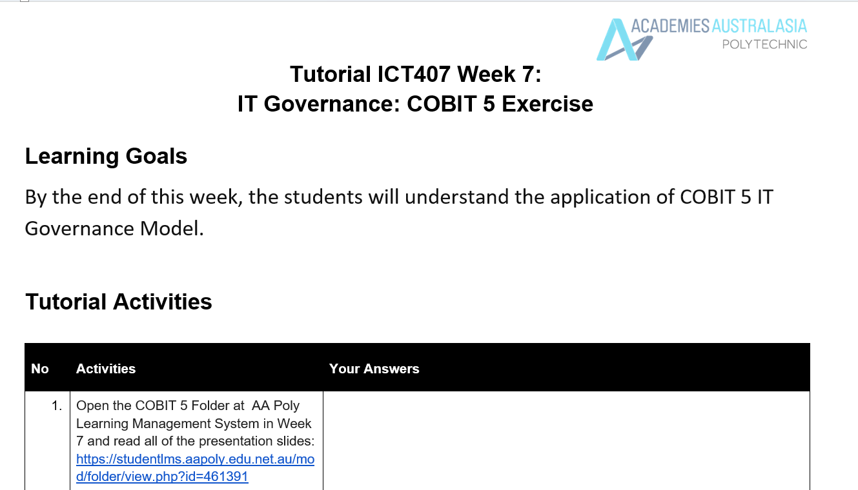
Tutorial Week 7

Slide 23
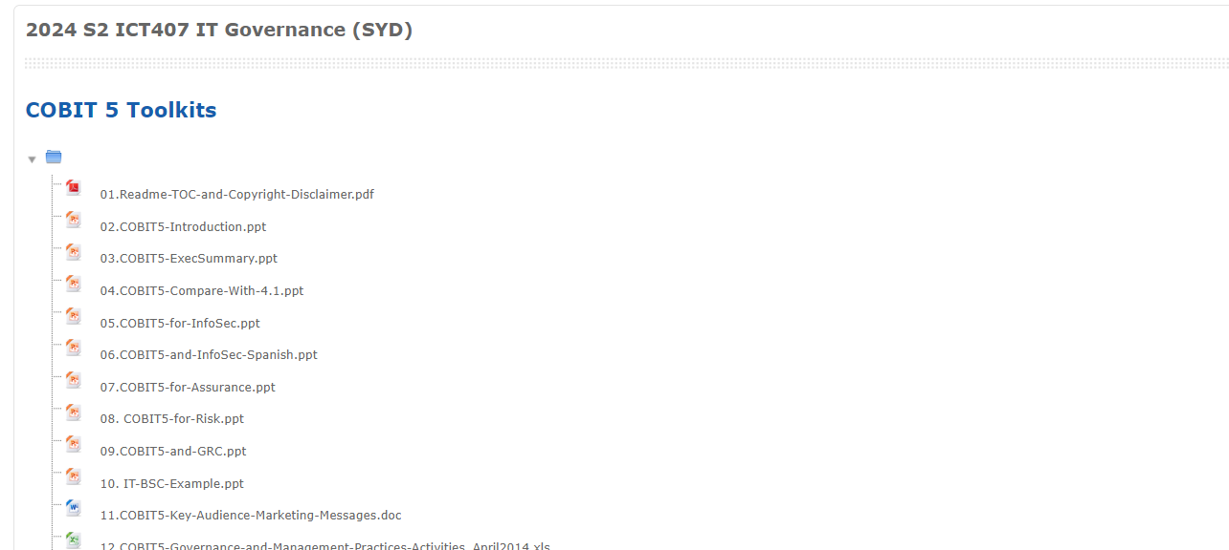
Tutorial Week 7

Slide 24
Tutorial Week 7
Analyse the case study of Alibaba using COBIT 5 Framework Model.
Discuss in a small group and write your answers in detail in the provided text field (min. 500 words).
Analyzing the Case Study of Alibaba Using the COBIT 5 Framework Model
Introduction to COBIT 5 and Alibaba's Business Context
The COBIT 5 framework is a comprehensive framework that helps organizations achieve their objectives for the governance and management of enterprise IT. The framework is built on five principles that guide enterprises in creating value from IT by balancing benefits, risk, and resource use.

Slide 25
Tutorial Week 7
The five COBIT 5 principles are:
Meeting Stakeholder Needs
Covering the Enterprise End-to-End
Applying a Single Integrated Framework
Enabling a Holistic Approach
Separating Governance from Management

Slide 26
Tutorial Week 7
Alibaba, one of the world's largest e-commerce companies, has successfully utilized technology, especially AI, to enhance customer experiences and foster innovation. This case study focuses on Alibaba's structure and how it supports technological disruption, which is crucial for understanding how COBIT 5 principles can be applied.

Slide 27
Applying COBIT 5 Principles to Alibaba
Meeting Stakeholder Needs: Alibaba's approach to meeting stakeholder needs aligns with COBIT 5's first principle. Alibaba focuses on using technology, such as AI and data analytics, to enhance customer experiences and drive innovation. This customer-centric approach ensures that stakeholder needs are met by offering personalized experiences and innovative products. Alibaba's DAMO Academy, the technology arm of the company, plays a crucial role in ensuring that the needs of different business units, such as Ant Group, AliCloud, and Tmall, are aligned with the overall business objectives. The COBIT 5 goals cascade can be applied here to translate stakeholder needs into enterprise goals, ensuring that the company remains competitive and customer-focused.

Slide 28
2. Covering the Enterprise End-to-End: Alibaba’s business model covers a broad spectrum of services, from e-commerce to cloud computing. The COBIT 5 framework's principle of covering the enterprise end-to-end is reflected in how Alibaba integrates its various business units, ensuring that IT is aligned with business objectives across the entire organization. This integration is essential for maintaining consistent quality and efficiency in operations, whether it is in customer service, product innovation, or IT infrastructure management. For instance, Alibaba's use of data across different platforms ensures that customer insights are leveraged across the enterprise, contributing to a seamless customer experience.

Slide 29
Tutorial Week 7
3. Applying a Single Integrated Framework: Alibaba’s technological infrastructure is designed to be cohesive and integrated across its various business units. COBIT 5’s emphasis on a single integrated framework resonates with Alibaba’s approach of using a unified technology stack to manage its diverse services, from e-commerce to cloud services. The integration ensures that all parts of the business can communicate effectively, share resources, and operate efficiently, which is critical for maintaining Alibaba's competitive edge in the market.

Slide 30
Tutorial Week 7
4. Enabling a Holistic Approach: Alibaba’s strategic use of AI and data analytics to drive innovation reflects a holistic approach to IT governance, as recommended by COBIT 5. By integrating AI into its business processes, Alibaba ensures that all parts of the organization contribute to innovation and customer satisfaction. This holistic approach is essential for sustaining long-term growth and competitiveness. For example, Alibaba’s Tmall Innovation Center uses customer data to co-create new products with partner brands, which exemplifies how the company integrates different business functions to achieve common goals.

Slide 31
Tutorial Week 7
5. Separating Governance from Management: Alibaba’s management structure, which emphasizes a flat and agile organization, is aligned with COBIT 5’s principle of separating governance from management. By delineating roles and responsibilities clearly, Alibaba ensures that governance (strategic direction, risk management, and performance monitoring) is distinct from management (day-to-day operations). This separation allows Alibaba to maintain agility in its operations while ensuring that strategic objectives are met. The governance of IT within Alibaba is focused on aligning IT initiatives with business goals, managing risks, and optimizing resources, which are core aspects of the COBIT 5 framework.

Slide 32
Tutorial Week 7
Conclusion
Alibaba's success in integrating AI into its business processes and fostering innovation can be analyzed effectively using the COBIT 5 framework. The principles of COBIT 5—meeting stakeholder needs, covering the enterprise end-to-end, applying a single integrated framework, enabling a holistic approach, and separating governance from management—are reflected in Alibaba’s strategic use of technology and its organizational structure. By adhering to these principles, Alibaba ensures that its IT governance supports the company’s overall goals, drives innovation, and enhances customer satisfaction.

Slide 33
Tutorial Week 7
Through the COBIT 5 lens, we can see that Alibaba’s approach to IT governance is not just about managing technology but about aligning IT with business objectives to create value for stakeholders. This alignment is crucial for sustaining Alibaba’s competitive advantage in the rapidly evolving global marketplace .

Slide 34
Tutorial Week 7
Analyse the case study of Teradata Global Consulting Service using COBIT 5 Framework Model.
Discuss in a small group and write your answers in detail in the provided text field (min. 500 words).

Slide 35
Tutorial Week 7
Introduction to COBIT 5 Framework
COBIT 5 (Control Objectives for Information and Related Technology) is a comprehensive framework for the governance and management of enterprise IT. It provides a structured approach that helps organizations achieve their IT-related objectives while balancing stakeholder needs, governance, and risk management. The framework integrates various IT processes, practices, and policies to ensure that IT aligns with the overall business goals of an organization.

Slide 36
Tutorial Week 7
Overview of the Teradata Global Consulting Service Case Study
Teradata Global Consulting Service is a part of Teradata Corporation, which provides consulting services for businesses to optimize and manage their data warehousing and analytics solutions. Teradata's Global Consulting Service operates on a global scale, offering strategic insights, implementation services, and ongoing management to help businesses harness the power of data.

Slide 37
Tutorial Week 7
The case study illustrates Teradata's challenges in managing its global operations, ensuring data integrity, and maintaining a high level of customer satisfaction. Key challenges include managing the complexity of global data governance, ensuring consistent service delivery, and aligning IT strategies with business objectives.

Slide 38
Tutorial Week 7
Analysis Using COBIT 5 Framework
1. Governance of Enterprise IT (GEIT)
Governance Objectives: Teradata's senior management must ensure that IT investments align with the overall business strategy. The COBIT 5 framework emphasizes the need for governance structures that evaluate, direct, and monitor IT performance. Teradata can implement a governance structure that regularly reviews IT performance against strategic business objectives.

Slide 39
Tutorial Week 7
Stakeholder Engagement: COBIT 5's principles highlight the importance of stakeholder engagement. Teradata can ensure that all key stakeholders, including clients and internal teams, are involved in decision-making processes to align IT services with business needs.

Slide 40
Tutorial Week 7
2. Align, Plan, and Organize (APO)
Strategic Alignment: The APO domain of COBIT 5 focuses on aligning IT strategy with business goals. Teradata must ensure that its IT strategy supports its global consulting services. This includes aligning its data management solutions with the needs of diverse clients across different regions.

Slide 41
Tutorial Week 7
Risk Management: Teradata should adopt a comprehensive risk management approach as outlined in COBIT 5. Identifying, assessing, and mitigating risks related to data governance and global operations is crucial. This could include implementing controls to protect data integrity and ensuring compliance with international regulations.

Slide 42
Tutorial Week 7
3. Build, Acquire, and Implement (BAI)
IT Implementation: In the BAI domain, COBIT 5 emphasizes the importance of building and implementing IT solutions that meet business needs. Teradata’s consulting service must ensure that its IT infrastructure is scalable and flexible to accommodate the needs of various clients. This includes the implementation of data warehousing solutions that can be customized for different industries.

Slide 43
Tutorial Week 7
Change Management: Teradata must adopt robust change management practices to manage the constant evolution of technology and business needs. COBIT 5 provides guidelines on how to manage changes in IT systems effectively, ensuring that service delivery is not disrupted.

Slide 44
Tutorial Week 7
4. Deliver, Service, and Support (DSS)
Service Delivery: The DSS domain focuses on delivering IT services that meet the expectations of stakeholders. Teradata must ensure consistent service delivery across its global operations. This includes implementing standardized processes and best practices to maintain the quality of service.

Slide 45
Tutorial Week 7
Problem and Incident Management: Teradata should adopt the COBIT 5 approach to managing problems and incidents. This involves having clear procedures for identifying, reporting, and resolving issues to minimize their impact on service delivery.

Slide 46
Tutorial Week 7
5. Monitor, Evaluate, and Assess (MEA)
Performance Monitoring: COBIT 5 highlights the need for continuous performance monitoring. Teradata should regularly assess its IT services to ensure they are meeting the required performance standards. This includes using key performance indicators (KPIs) to measure the effectiveness of IT governance and management practices.

Slide 47
Tutorial Week 7
Compliance and Assurance: Teradata must ensure compliance with relevant regulations and industry standards. COBIT 5 provides a framework for monitoring compliance and providing assurance that IT processes are functioning as intended.

Slide 48
Tutorial Week 7
Conclusion
By leveraging the COBIT 5 framework, Teradata Global Consulting Service can strengthen its IT governance and management practices. This will enable the company to align its IT services with business objectives, manage risks effectively, and deliver consistent, high-quality services to its global client base. Implementing COBIT 5 will also help Teradata maintain compliance with international standards and regulations, ensuring the long-term success of its global operations.

